Slide 1
The Final Presentation
My portfolio...

Slide 2
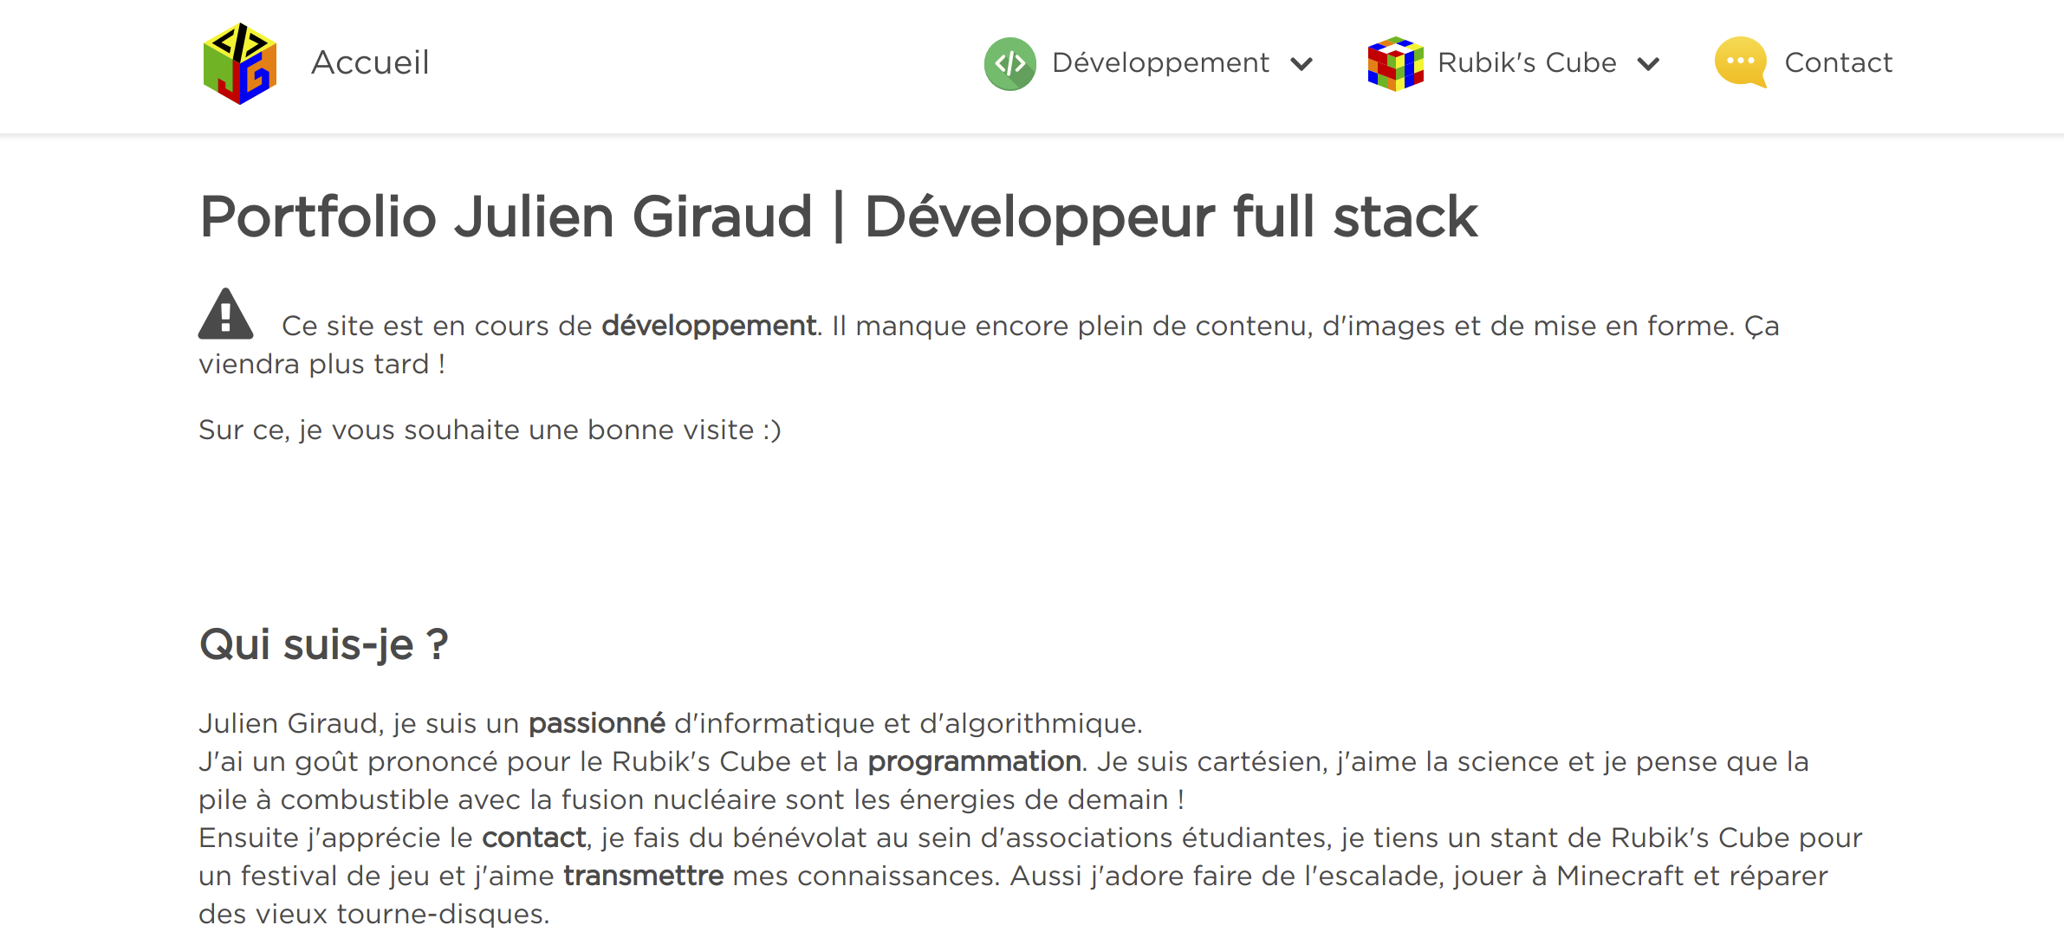
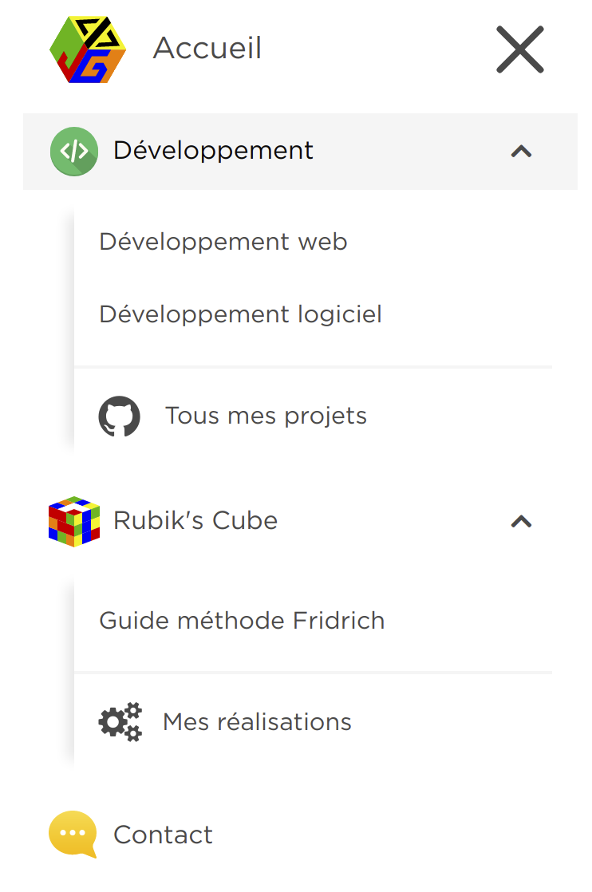
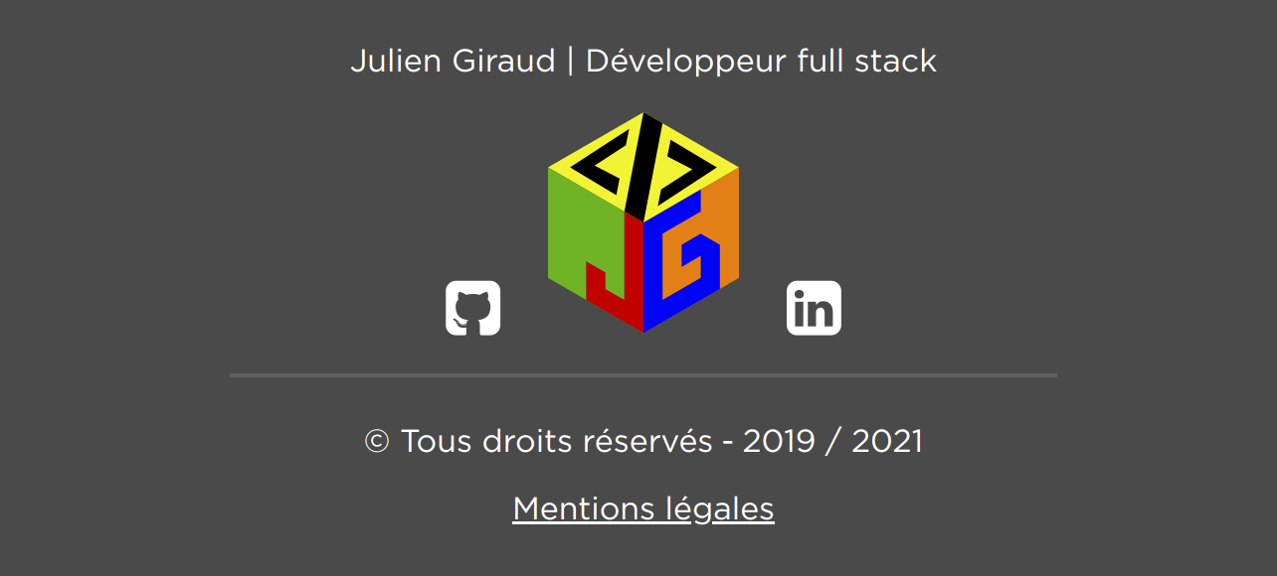
Website Structure

Slide 3
Main Page Content 1/4

Slide 4
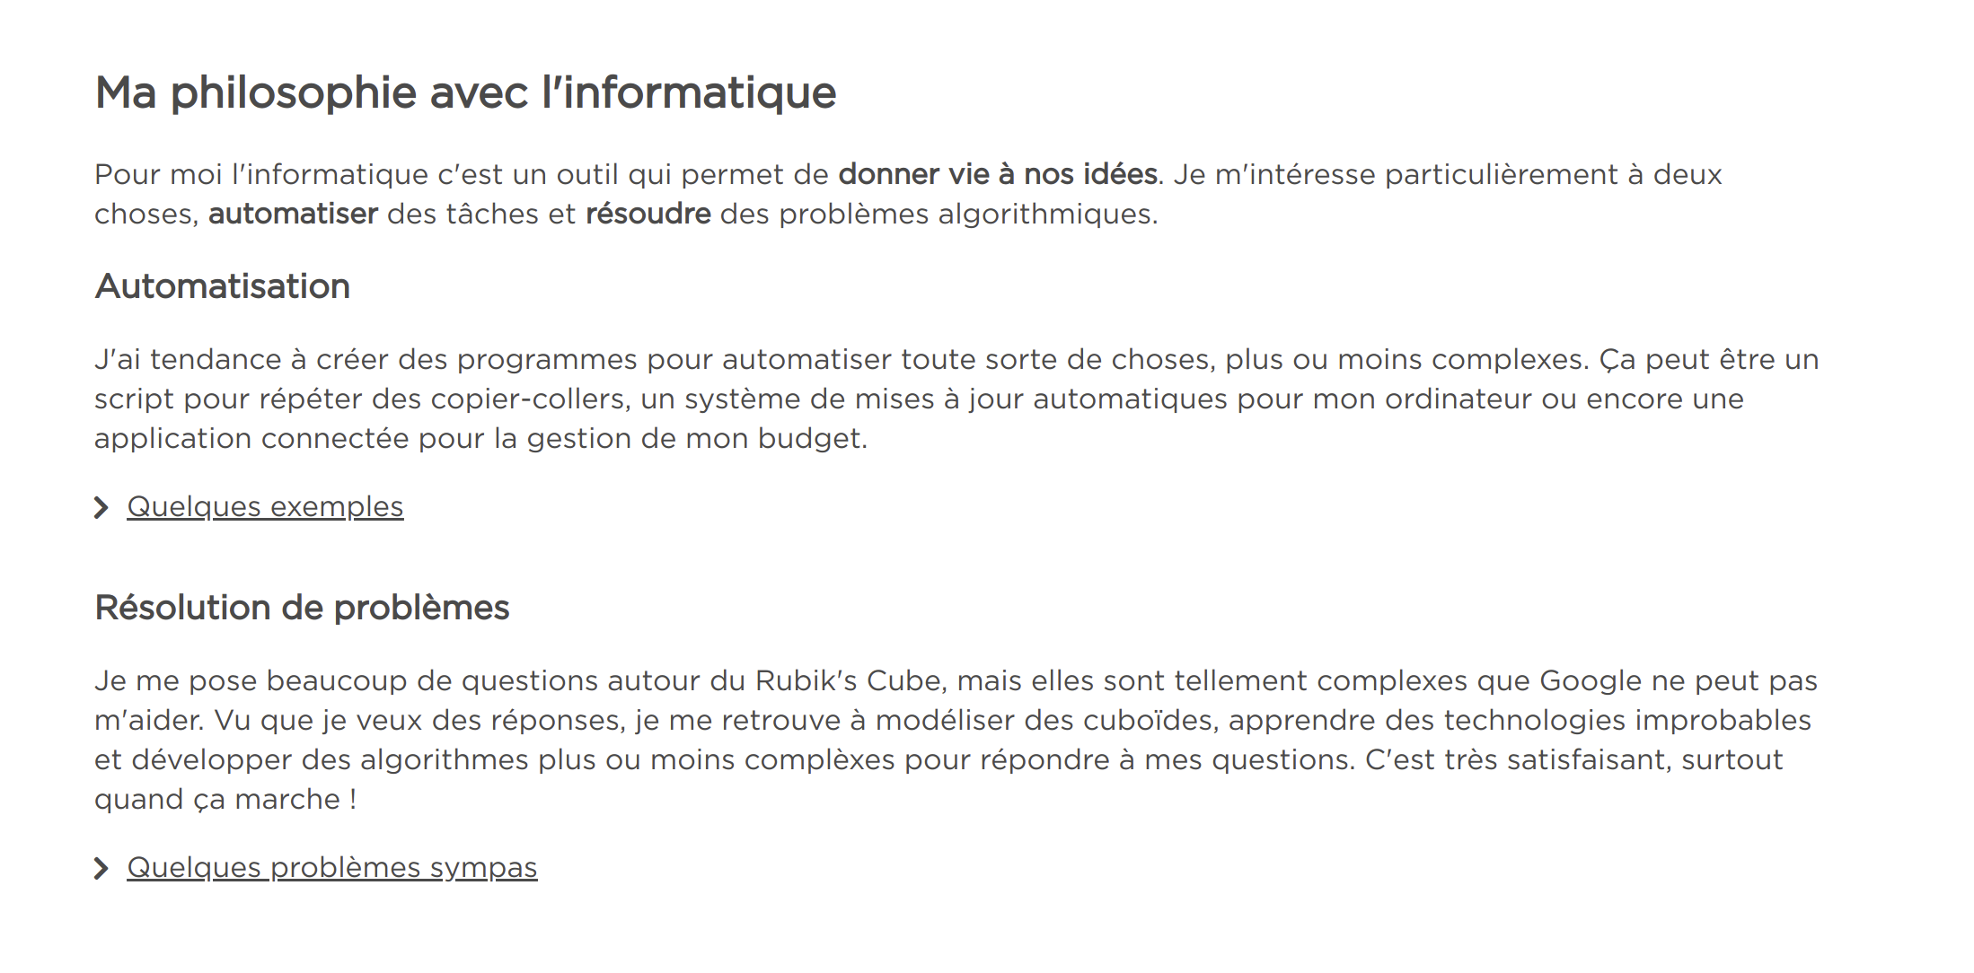
Main Page Content 2/4

Slide 5
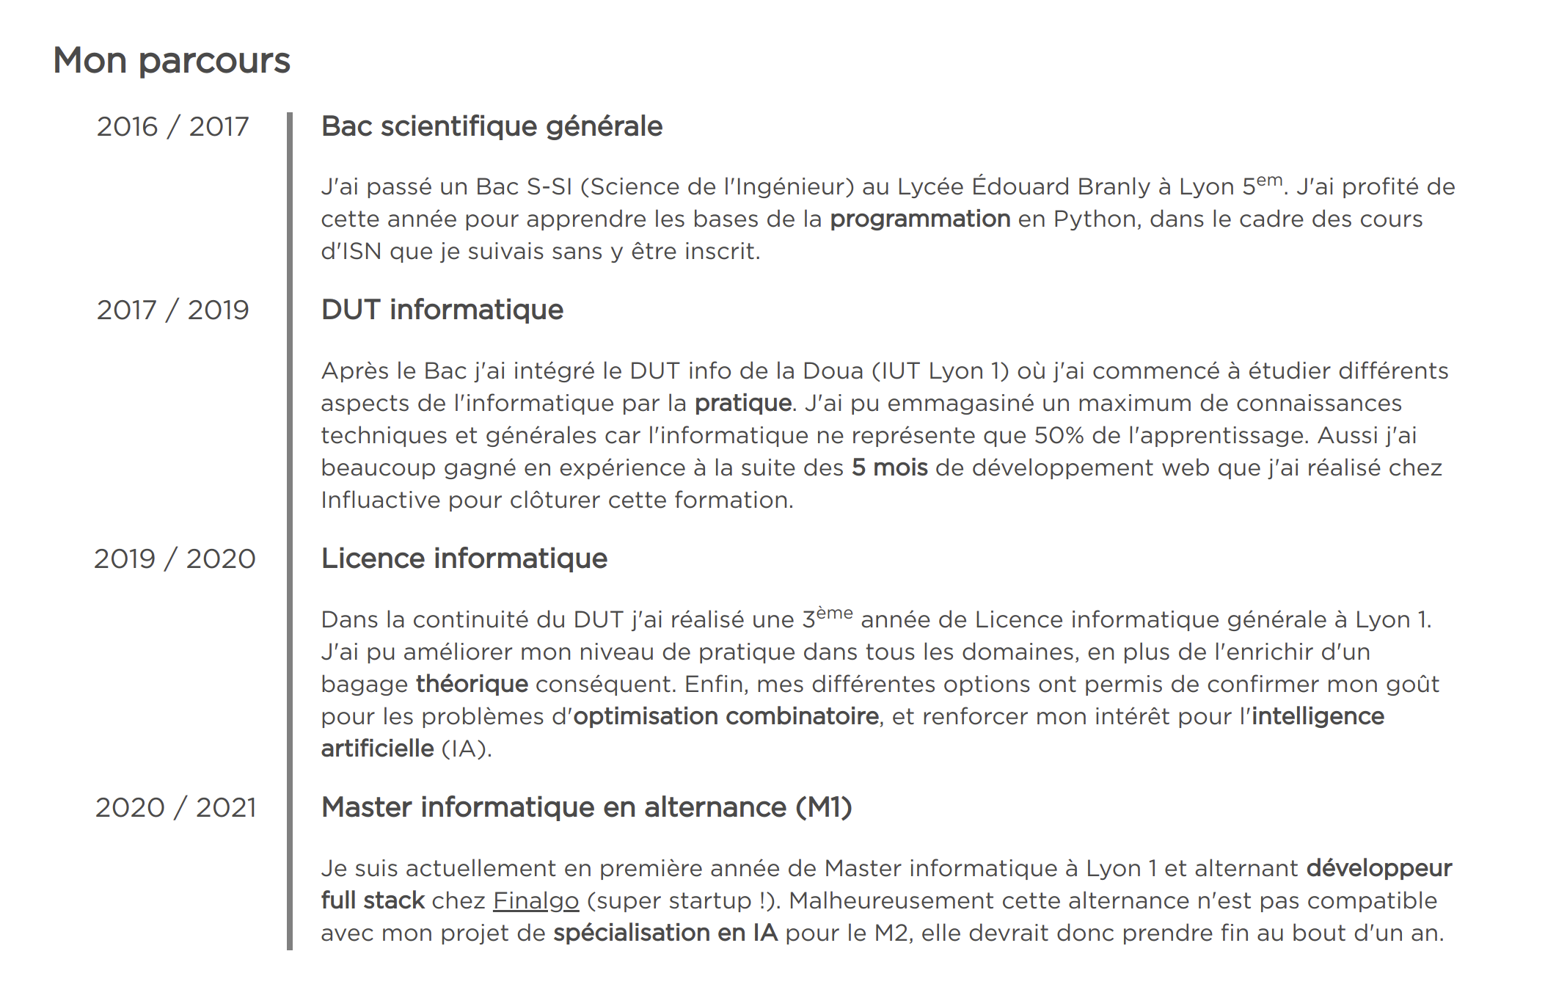
Main Page Content 3/4

Slide 6
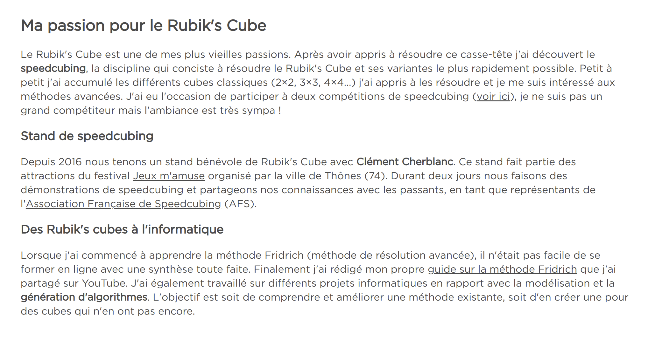
Main Page Content 4/4

Slide 7
Let’s follow the links to my GitHub account.

Slide 8
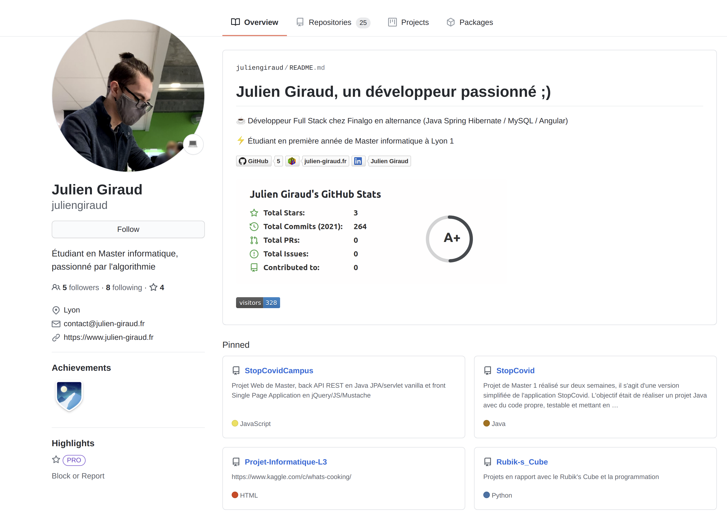
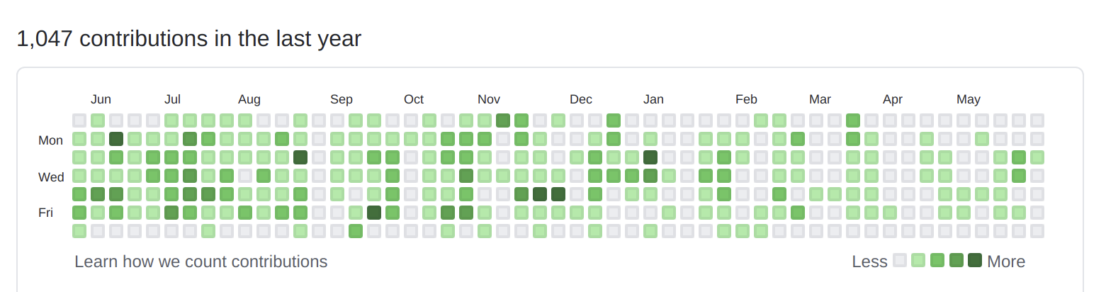
My Github Home Page

Slide 9
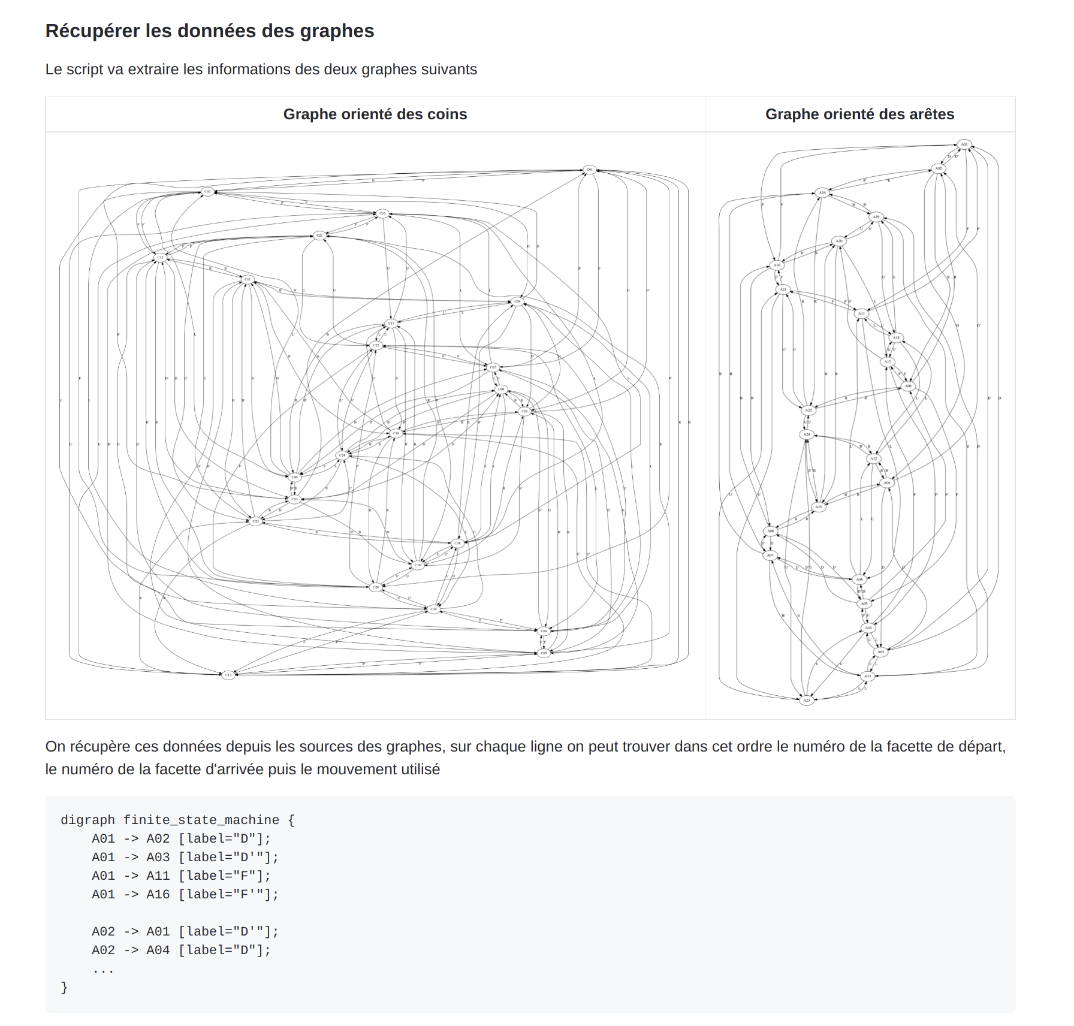
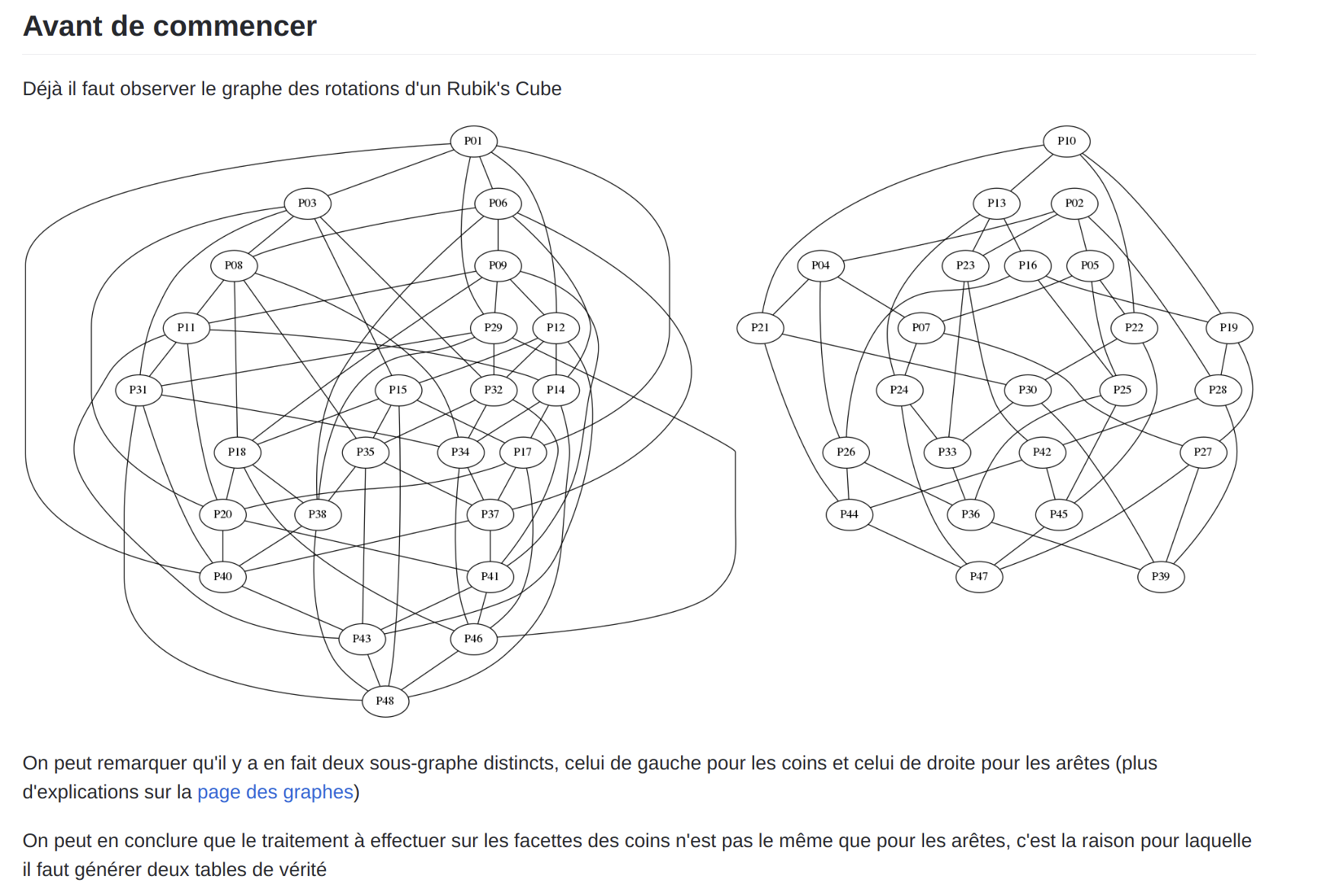
My Projects on GitHub 1/3

Slide 10
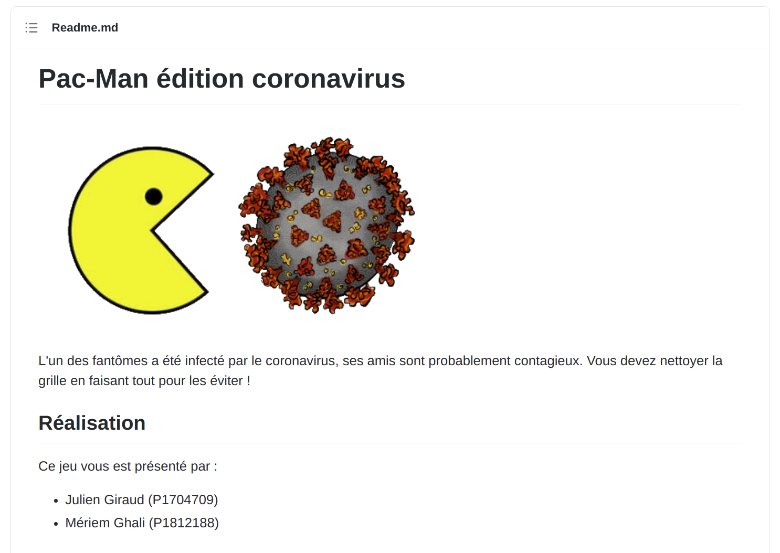
My Projects on GitHub 2/3

Slide 11
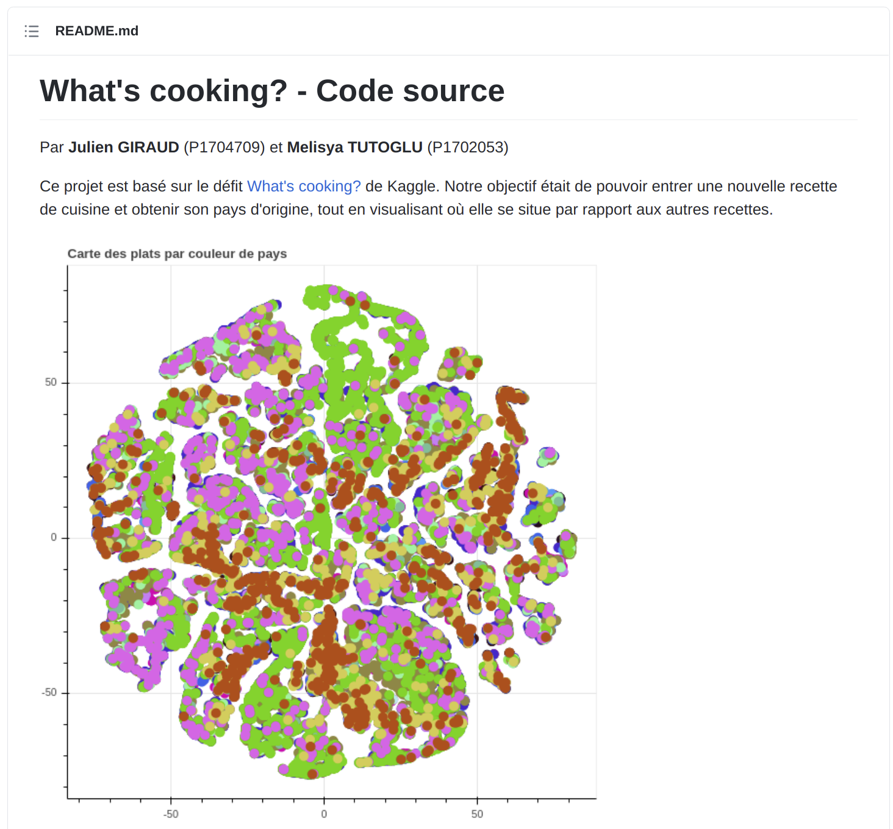
My Projects on GitHub 3/3

Slide 12
Let’s go back to the portfolio.

Slide 13

Rubik’s Cube Page 1/3

Slide 14
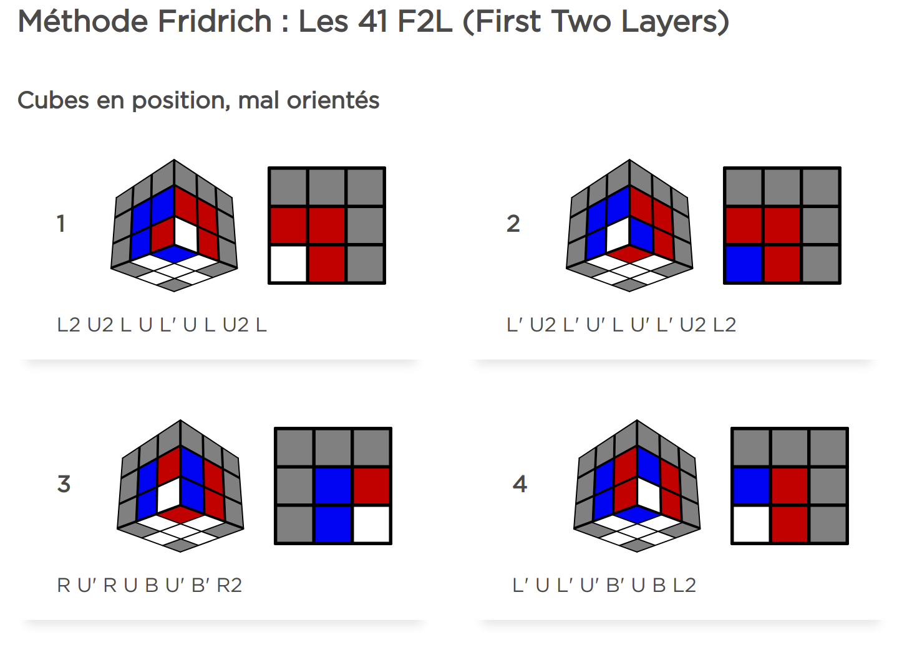
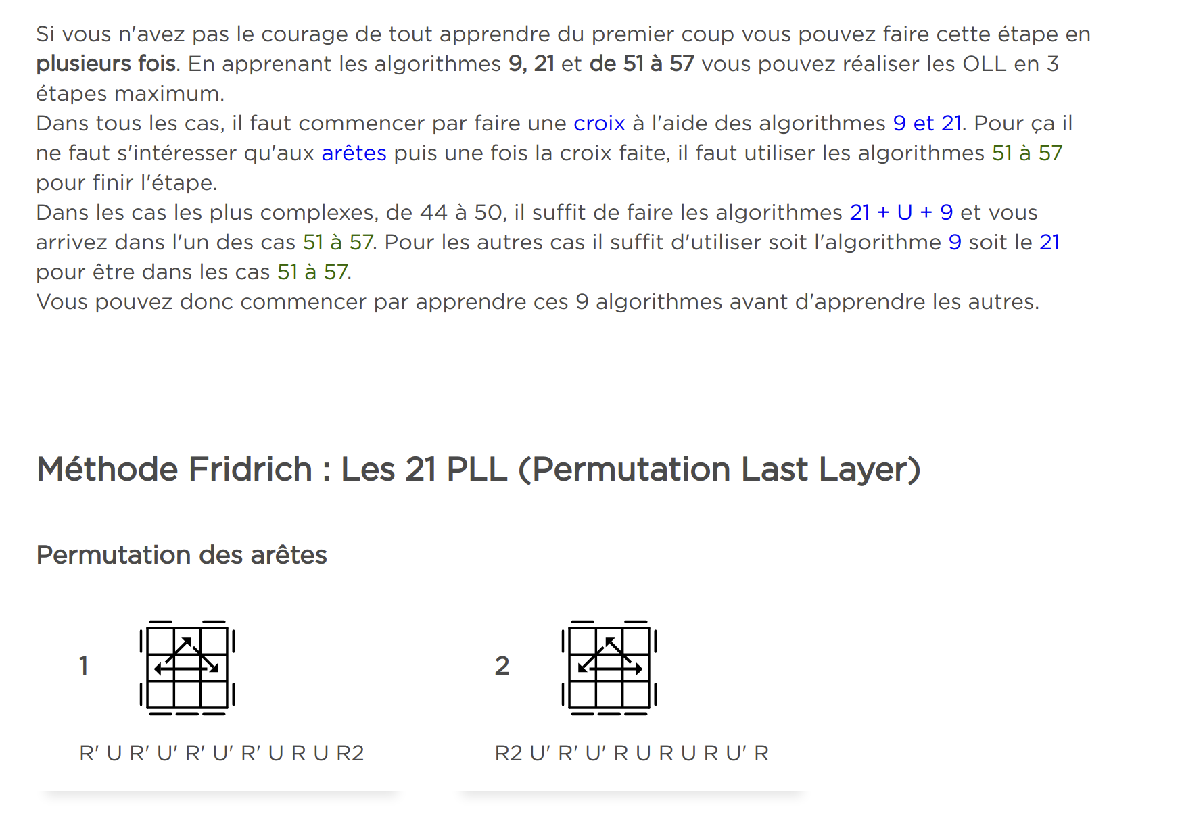
Rubik’s Cube Page 2/3

Slide 15
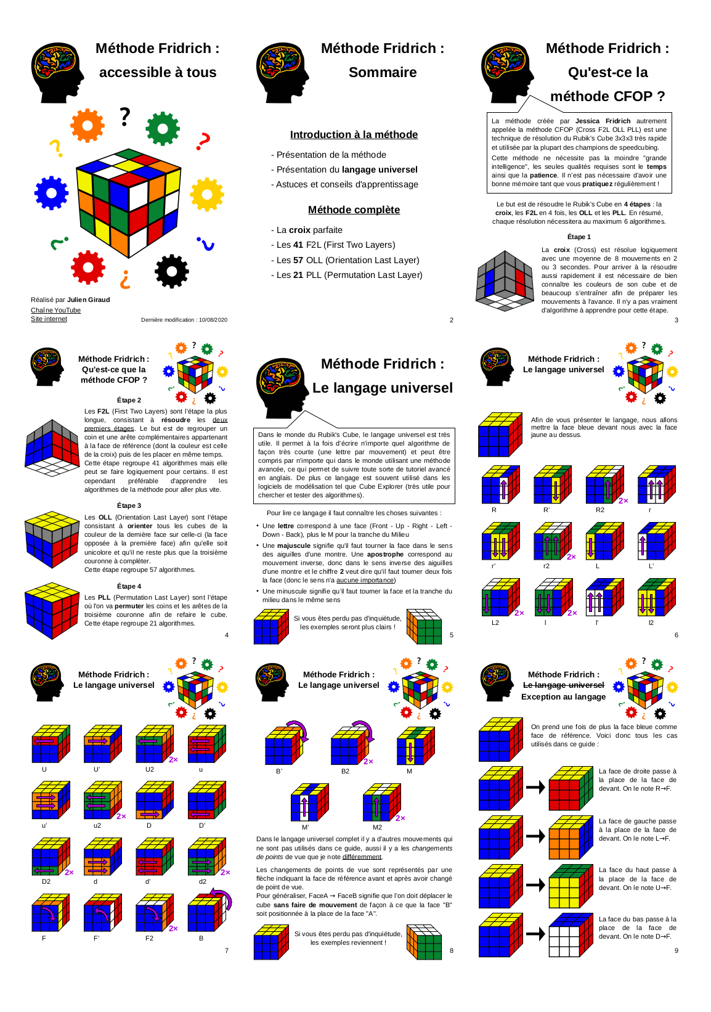
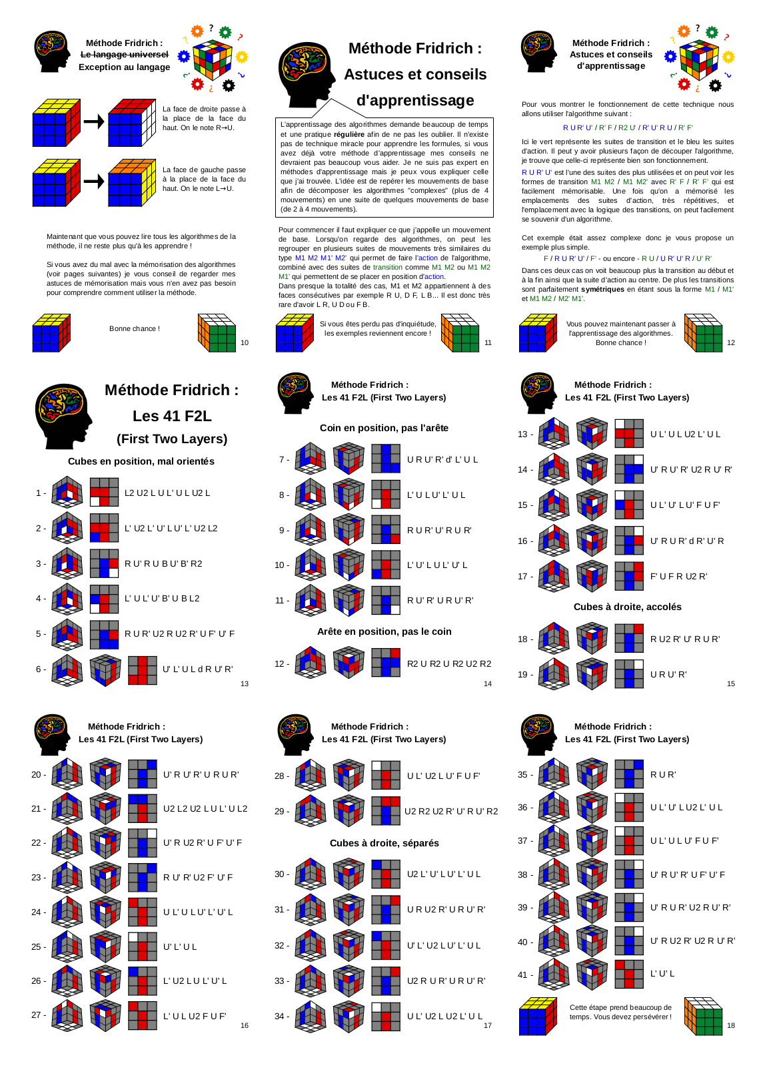
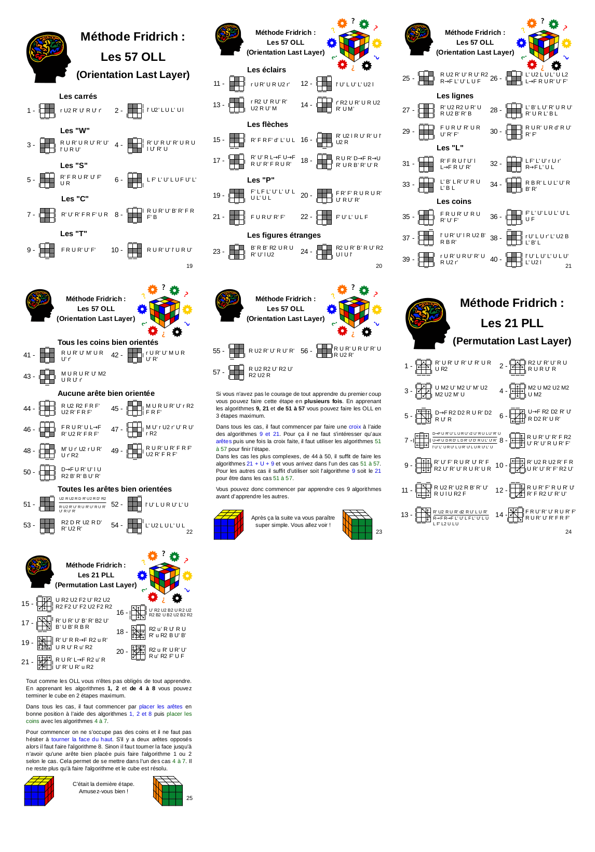
Rubik’s Cube Page 3/3
* 1/9 size PDF preview.

Slide 16
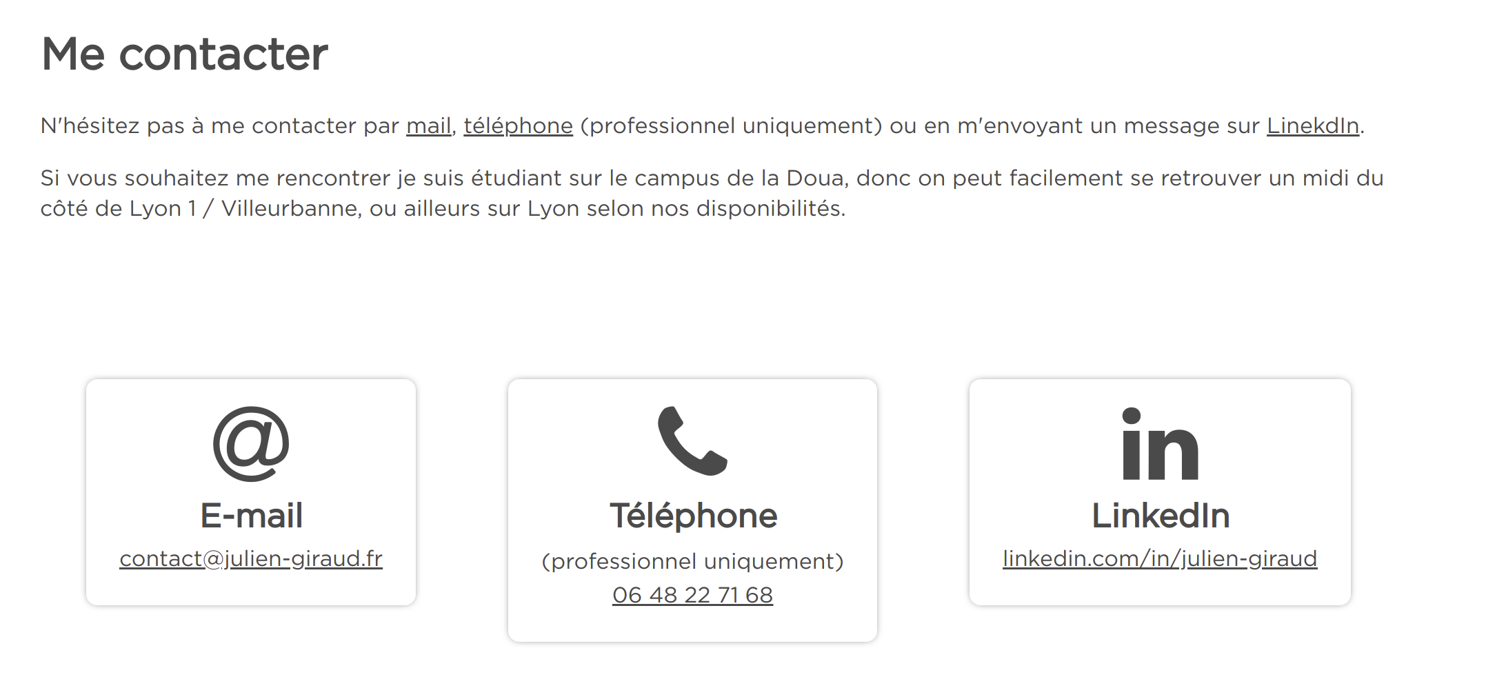
Contact Page

Slide 17
Thank you.

